Slide 1

Local Power Plan
How members and local parties can get involved

Slide 2
What is community energy?
Community energy projects are community-led and owned renewable energy developments – helping to generate energy, store energy and improve energy efficiency.
Community ownership means local residents become co-owners of installations. These co-owners are part of a democratically-run enterprise, which generates and delivers energy to the grid – helping to power homes across the country.

Slide 3
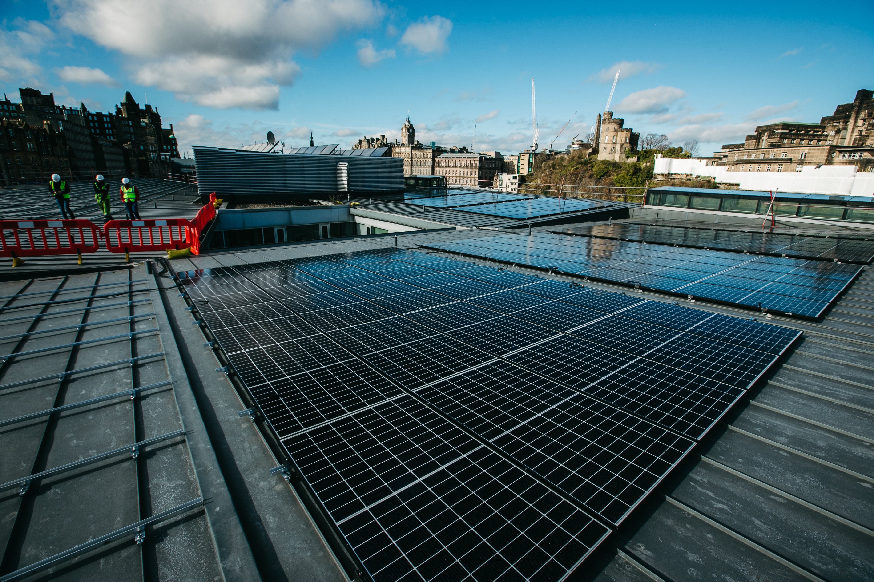
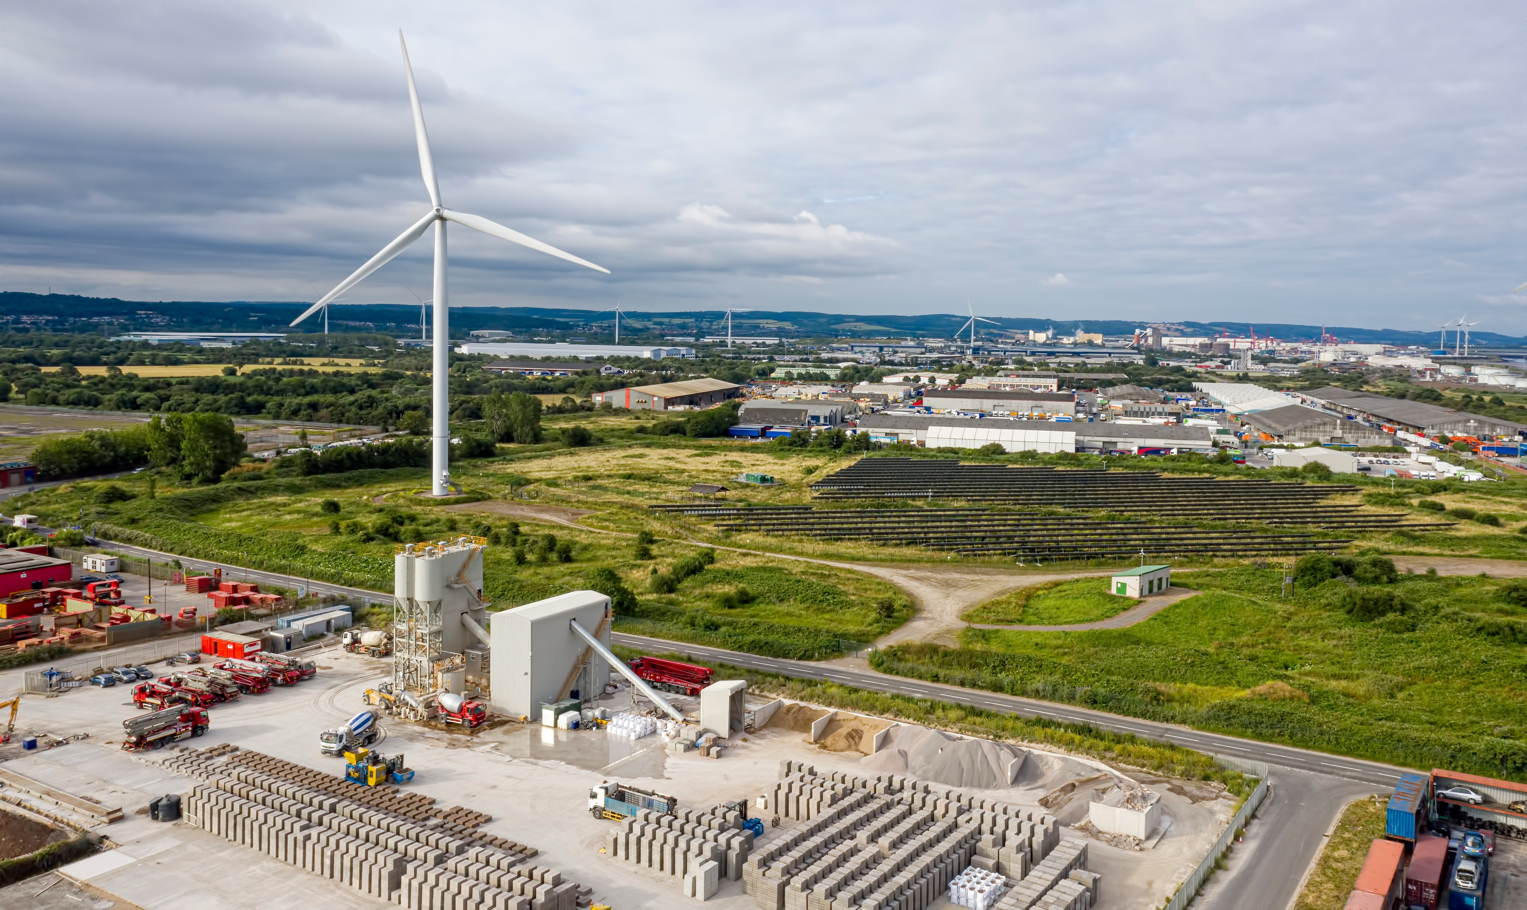
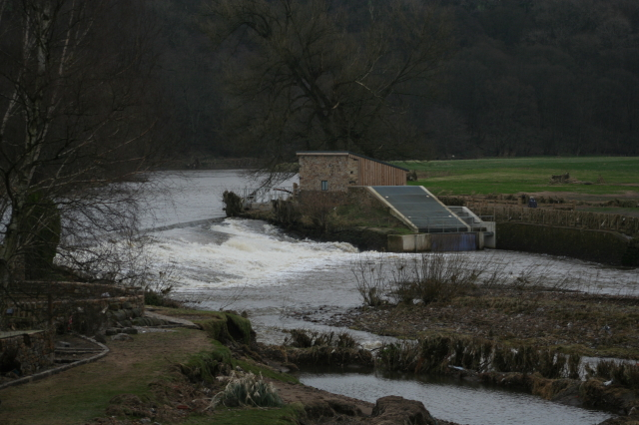
Types of community energy
Solar
Wind
Hydro
Edinburgh Community Solar Co-operative
Ambition Lawrence Weston
Whalley Community Hydro

Slide 4
The UK Community Energy Sector
Community energy already has a growing presence across the UK
614
212,960
Community energy organisations
Members
£68.5m
£1.86m
Annual turnover
Saved from
energy bills
Source: Community Energy:
State of the Sector 2025

Slide 5
Why community energy can be beneficial to you & your community
Increased generation & uptake of renewable energy
Community empowerment & engagement
Climate education
Reduced energy bills
Reduced fuel poverty
Lower carbon emissions
New local job opportunities

Slide 6
Local Power Plan: What is it?
The Local Power Plan is the Government’s newly launched strategy for delivering the largest ever expansion of community-owned green energy.
The Local Power Plan is part of delivering the Labour Government’s world-leading double the size of the co-op sector commitment.
The new Local Power Plan, delivered by Great British Energy (GBE), will provide £1bn to support the scale up of renewable energy projects.
GBE will provide a package of support to local residents, local authorities, and new and existing community energy groups.
GBE Local Power Plan website

Slide 7
Local Power Plan: How will it work?
The Local Power Plan will provide support through a range of interventions & will be available in the devolved nations – Scotland, Wales & Northern Ireland.
Direct Funding
Funding support at every stage of development – from feasibility to delivery
Expertise & Advice Services
Accessible support services for those looking to develop, expand, install & diversify
Policy & Regulatory Reform
Clearing regulatory barriers – making it easier to access the grid & install projects

Slide 8
Local Power Plan: The role of councils
Councils & Councillors will have a central role in helping to deliver the LPP. Below are ideas for how councils can support new community energy development:
Work with existing community energy groups
Make public assets available for installations (i.e. roof space, buildings, land, etc.)
Invest in new community energy
Establish supportive council policies
Have the council purchase community energy
Provide training programmes for those interested in community energy

Slide 9
Local Power Plan: Find our more
If you or your organisation want to find out more about the Local Power Plan or community energy, please view these resources:
GBE – Local Power Plan Announcement
GBE – Expression of Interest in Local Power Plan
Co-operative Party – Community Energy Campaign Guide
Community Energy England – Website
Community Energy Wales
Community Energy Scotland

Slide 10
For more information please contact:
Daniel Monaghan
Policy Officer policy@party.coop
Thanks

